Slide 1


DAYANANDA SAGAR UNIVERSITY
SCHOOL OF ENGINEERING
Computer Science and Engineering (AIML)
Minor Project Phase-I
TRIP BUDGET MANAGER
Under the Supervision
PROJECT GUIDE: DR. SUGANDHA SAXENA
PROF. BHUVANA MOHINI
Presented By:
TEAM MEMBER 1: MANCHALA SAI KIRAN (ENG24AM0216)
TEAM MEMBER 2: RAHUL S (ENG24AM0257)
DAYANANDA SAGAR UNIVERSITY
Notes:
Title of the project
CSE Dept., SET-Jain University

Slide 2
TITLE:TRIP BUDGET MANAGER
PROJECT GUIDE: DR. SUGANDHA SAXENA / PROF. BHUVANA MOHINI
ASSISTANT PROFESSOR
DAYANANDA SAGAR UNIVERSITY
BENGALURU, HAROHALLI
DAYANANDA SAGAR UNIVERSITY
(#) of 12

Slide 3
Content
Introduction
Literature Review
Problem Statement
Aim & Objectives
Methodology
Results and Discussion
References
DAYANANDA SAGAR UNIVERSITY
<number> of 12

Slide 4
Introduction
• What: Trip Budget Manager is a web-based application to plan and track travel expenses for pilgrimage and leisure trips.
• Why: Travelers often overspend due to lack of real-time budget tracking. This tool solves that by providing instant expense logging, daily allowance calculation, and a visual budget summary all without any internet or server dependency.
• Graphical Abstract idea:
Registers
Selects Destination
Sets Budget
Logs Expenses
Views Dashboard
DAYANANDA SAGAR UNIVERSITY
<number> of 12

Slide 5
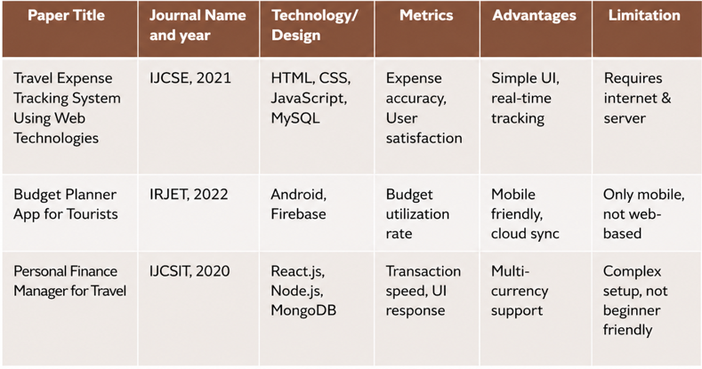

Literature Review
DAYANANDA SAGAR UNIVERSITY
<number> of 12

Slide 6
Problem Statement
• Problem: Travelers have no simple tool to track trip expenses, so they overspend easily.
• Solution: A website where users set a budget, add expenses by category, and see remaining balance — works fully offline, no app needed.
• Research Gap: Existing tools need mobile apps or internet. No simple offline web tool exists for Indian pilgrimage travel.
DAYANANDA SAGAR UNIVERSITY
<number> of 12

Slide 7
Aim & Objective
Aim: To build a simple website that helps travelers manage their trip budget easily without needing any app or internet connection.
Objective:
• Allow users to register and log in securely
• Let users set a total trip budget and number of days
• Enable adding expenses by category (food, travel, stay, etc.)
• Show remaining balance and daily allowance automatically
• Save all data locally in the browser
DAYANANDA SAGAR UNIVERSITY
<number> of 12

Slide 8
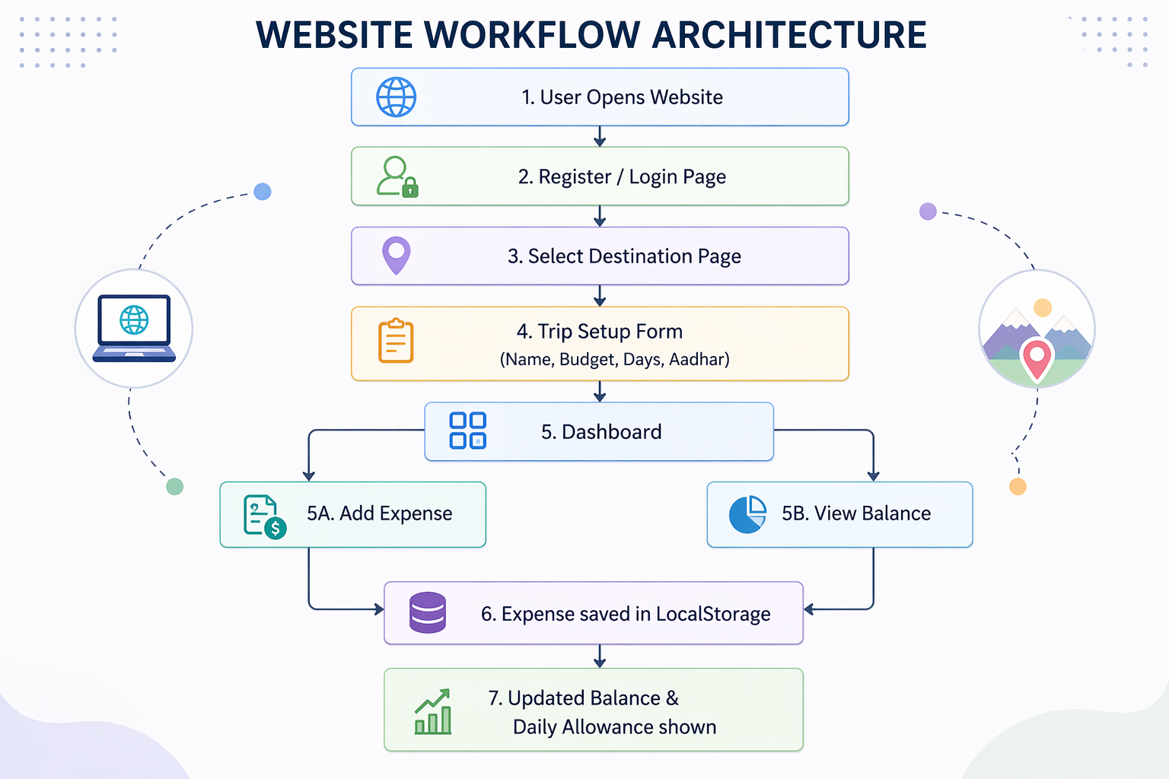
Model Architecture in detail
DAYANANDA SAGAR UNIVERSITY
<number> of 12

Slide 9
Methodology:
• Designed the UI using HTML and Tailwind CSS
• Used JavaScript to handle login, budget calculation, and expense tracking
• Stored user data using browser’s local Storage and session Storage.
• Tested the website on different screen sizes and browsers.
DAYANANDA SAGAR UNIVERSITY
<number> of 12

Slide 10
Results and Discussion:
• Login & Register works successfully Users can create an account and log in. Wrong password shows an error message correctly.
• Budget Dashboard loads correctly Total budget, remaining balance and daily allowance are displayed and update in real time when expenses are added.
• Expense Tracking works as expected Users can add expenses by category (food, travel, stay etc.) and delete them anytime.
• Data is saved in browser All trip data stays saved even after refreshing the page using local Storage and session Storage.
• Website works on all screen sizes Tested on mobile and desktop layout adjusts properly on all devices.
• Gallery and Temple selection works Users can browse pilgrimage destinations and auto-fill budget by clicking on a temple card.
DAYANANDA SAGAR UNIVERSITY
<number> of 12

Slide 11
References
[1] GOOGLE GEMINI AI, "ASSISTANCE IN UI DESIGN AND CODE GENERATION FOR TRIP BUDGET MANAGER“ GOOGLE LLC 2024
[2] TAILWIND CSS DOCUMENTATION, "UTILITY-FIRST CSS FRAMEWORK", 2024.
[3] LUCIDE ICONS, "OPEN SOURCE ICON LIBRARY"
[4] MDN WEB DOCS, "LOCALSTORAGE AND SESSION STORAGE API" MOZILLA
DAYANANDA SAGAR UNIVERSITY
<number> of 12

